Slide 2
INTERFACES BETWEEN
DISTRIBUTED AND
CENTRALIZED
TECHNOLOGIES
Atle Midttun
Adapted from MIT (2006)
Distrib. Energy Res
Demand Response
Electric Vehicles
Small Scale Storage
Micro-Cogeneration
Micro-Turbines
Rooftop Solar
Small Biomass
Small Hydro
Non-Intermittent
Intermittent
Nuclear
Gas
Coal
Large Biomass
Large Hydro
Large Solar PV
Wind Farms
MIT (2016):
UTILITY OF THE FUTURE
An MIT Energy Initiative response
to an industry in transition
Central. Energy Res

Slide 3
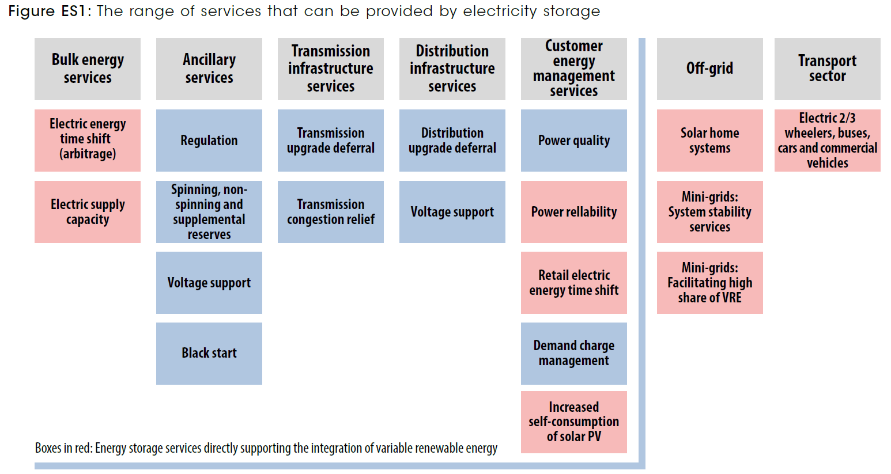

Slide 4
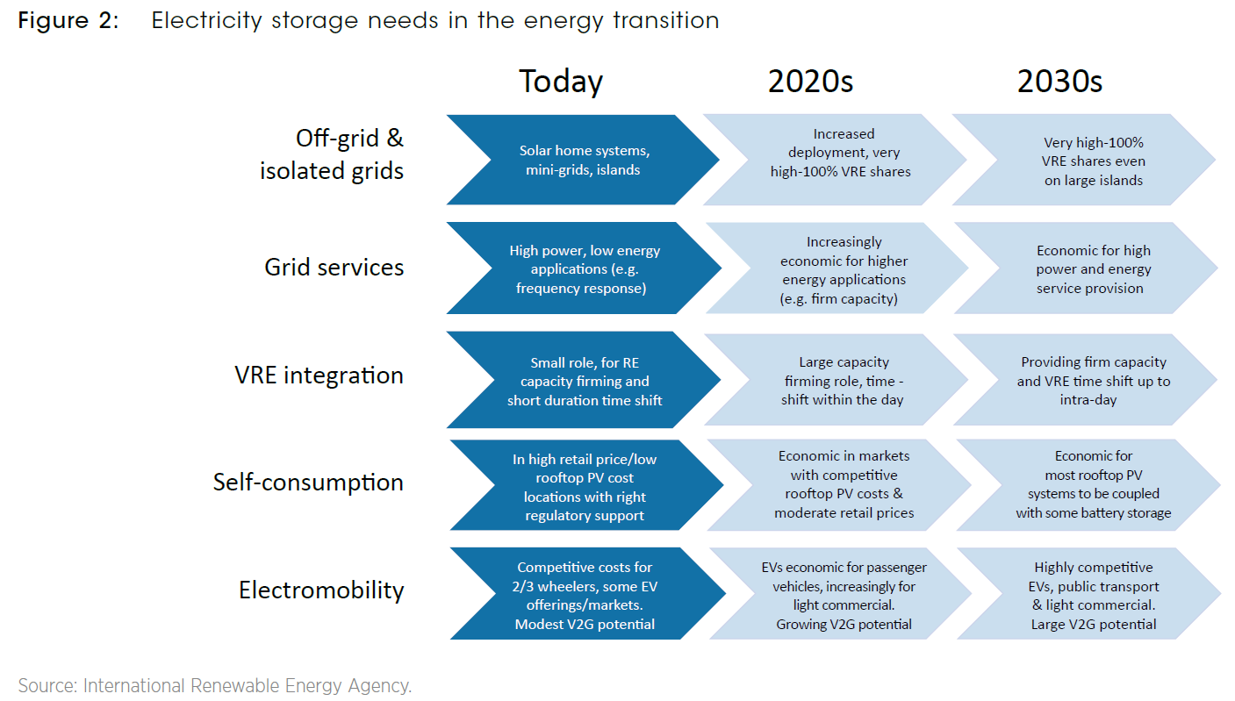

Slide 5
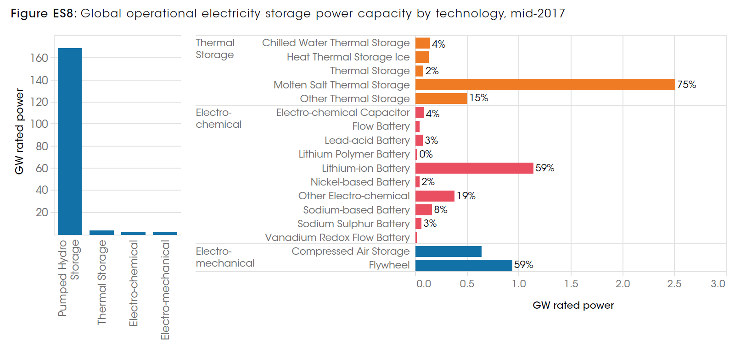

Slide 6
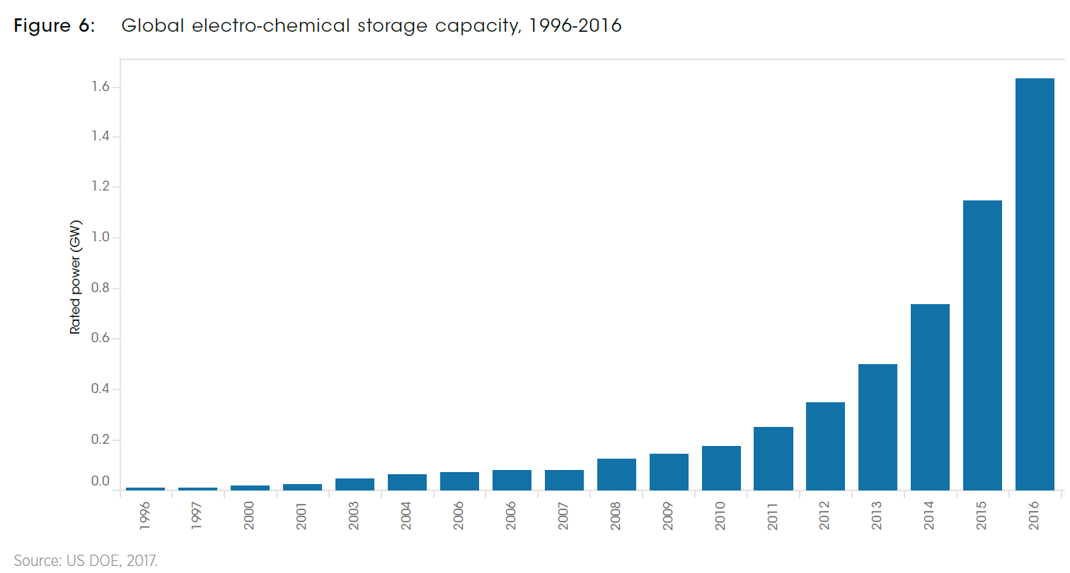

Slide 7
