Slide 1
Program – Nye aktører og forretningsmodeller i petroleum og el
12.30: Velkommen og åpning ved Jon Lereim og Atle Midttun, Senterledere BI Senter for energi
Del I: Nye aktører og forretningsmodeller innen petroleum
12.50: Case Cognite – John Markus Lervik, Administrerende direktør i Cognite
13.10: Utfordringer for olje og gass på norsk sokkel - Bjørn Vidar Lerøen, Daglig leder Lerøen Media og tidl. spes. rådg. Statoil og Norsk olje og gass
13.30: Kommentarer:
Preben Strøm, Daglig leder i Subsea Valley
Martin S. Foss, Forskningsdirektør ved Institutt for Energiteknikk (IFE)
13.50: Diskusjon og spørsmål fra salen
14.15 – 14.30 Kaffe
Del II: Nye aktører/forretningsmodeller innen el og varme
14.30: Case Rock Energy – Thor Erik Museæus, Administrerende direktør i Rock Energy
14.50: Case FUSen Energi – Thor Christian Tuv, Daglig leder i FUSen
15.10: Kommentarer:
Bente Hagem, EVP for European Affairs i Statnett
Henrik Sætness, SVP for Corporate Strategy and Analysis i Statkraft
15:30 Diskusjon og spørsmål fra salen

Slide 2
Value Optimization Conceptual Framework
Value added potential by
Business solution optimization
Optimization performance on business conditions
Business solution optimization
Energy Technology solution optimization
A commercial operational perspective
Jon Lereim

Slide 3
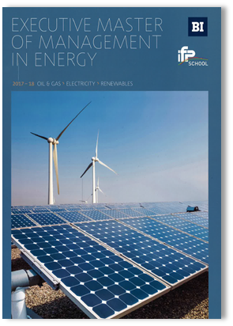
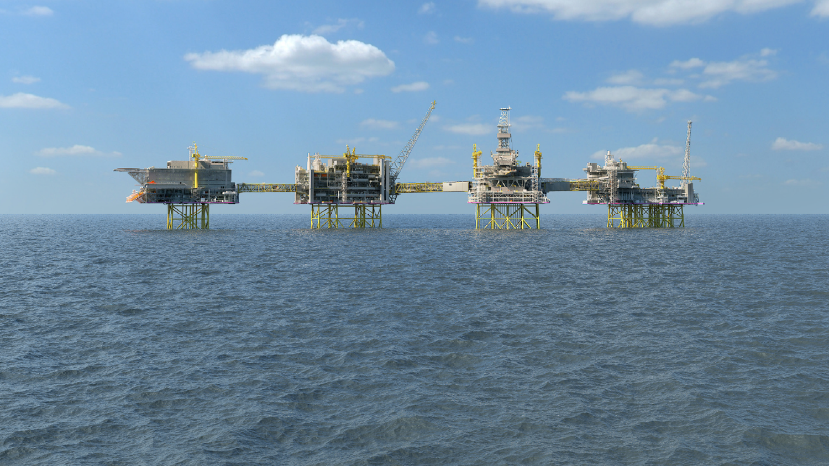
Executive Master of Management in Energy An industry focused approach
Fossil & renewables
Upstream & downstream
Collaboration BI & IFP
Strategic alliance IFE
Polytechnic approach
Truly international

Slide 4
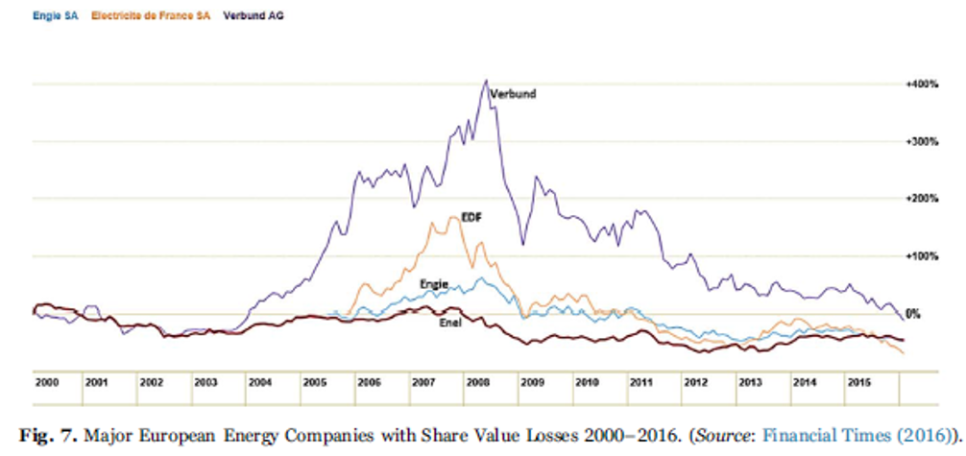
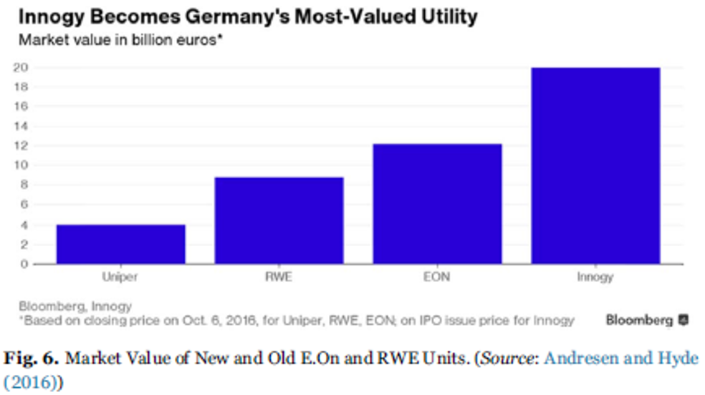
The Rise and Fall of
Conventional Power
In the 21st Century
Two energy worlds
The energy landscape has shifted. Changing customer behavior, new technology, and increasingly global markets are creating two distinct energy worlds. The classic energy world has the indispensable task of ensuring supply security. Alongside it is emerging the new world of distributed energy solutions.
Uniper’s portfolio combines large-scale power generation and the effective management of global and regional energy supply chains.
E.ON, our former parent company, will focus on the new energy world with renewables, distribution networks, and customer solutions.
Both worlds require distinctive business models and capabilities.
Both worlds present challenges and opportunities.
Both worlds are needed to meet the world’s energy needs in the decades ahead.

Slide 5
INTERFACES BETWEEN
DISTRIBUTED AND
CENTRALIZED
TECHNOLOGIES
Atle Midttun
Adapted from MIT (2006)
Distrib. Energy Res
Markets and Incentives Across Technologies
Grid Systems Interconnecting Technologies
ICT Integration Across Technologies
Demand Response
Electric Vehicles
Small Scale Storage
Micro-Cogeneration
Micro-Turbines
Rooftop Solar
Small Biomass
Small Hydro
Non-Intermittent
Intermittent
Nuclear
Gas
Coal
Large Biomass
Large Hydro
Large Solar PV
Wind Farms
MIT (2016):
UTILITY OF THE FUTURE
An MIT Energy Initiative response
to an industry in transition
Central. Energy Res

